Slide 1
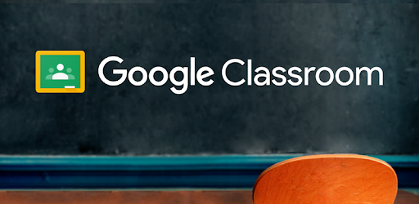
Saving your work

Slide 2
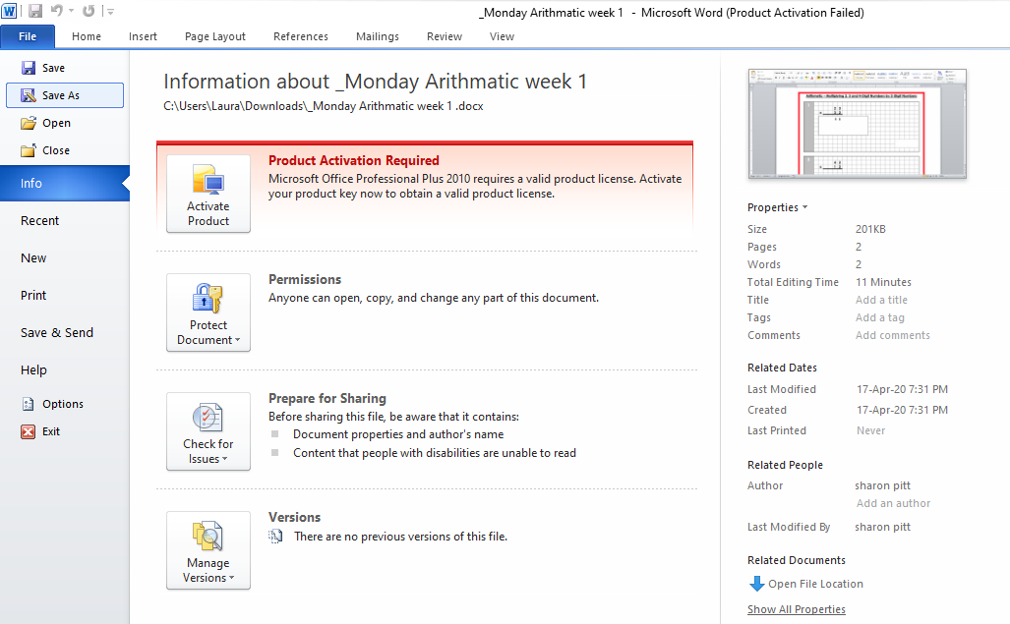
Click
File
Save as

Slide 3
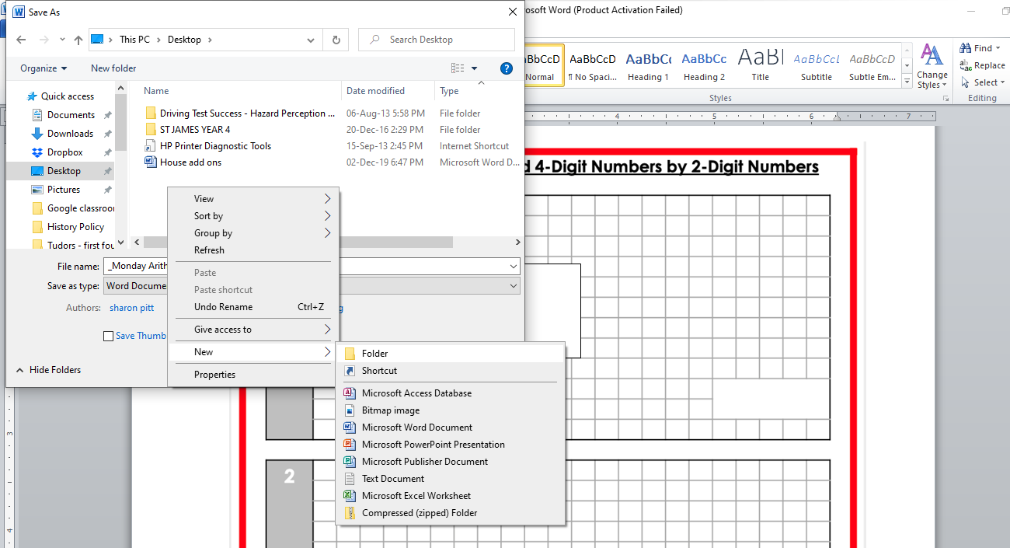
I am going to save it on the desktop so that I can easily find my work.
Once you have opened the desktop folder, right click and select ‘new’ and ‘folder’

Slide 4
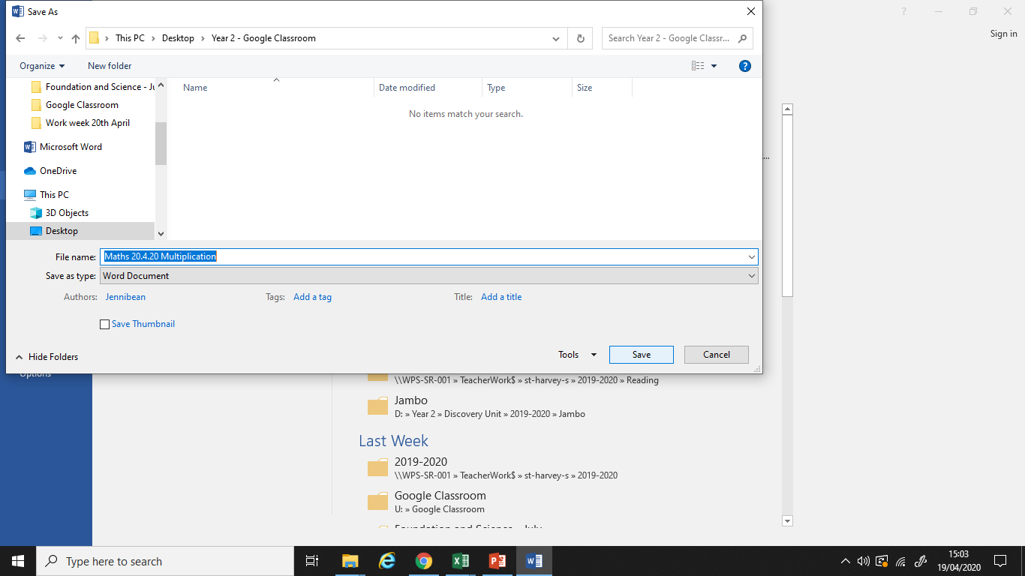
You will need to name your folder (example- ‘Year 4 – Google classroom’) and the document ‘Maths 20.4.20’
Then click save.
This example is named ‘Year 2 – Google classroom’ and the document ‘Maths 20.4.20 - Multiplication’.
You only need to create the folder once. The next time you need to locate the folder and save your work in it ☺

Slide 5
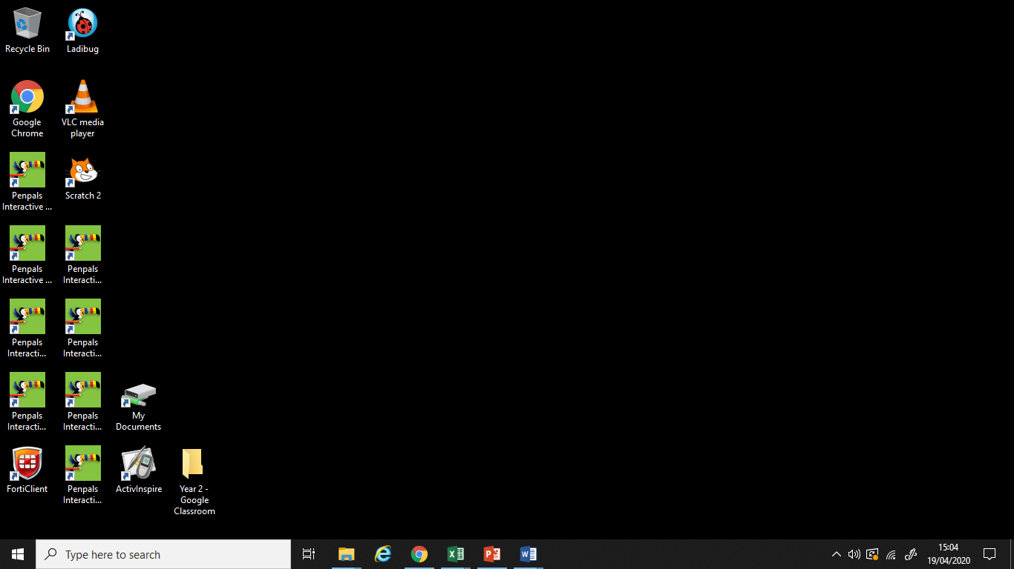
You should notice the folder you have created on the home page on your device.

Slide 6
Next time you come to save your work
Click file and save as
Click desktop on the left hand side and double click on your folder
Name your document
Click save

