Slide 1
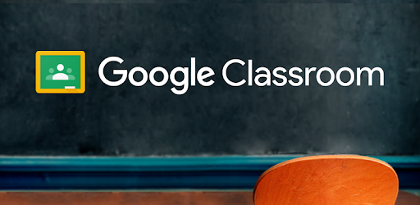
How to edit your work from Google Classroom

Slide 2
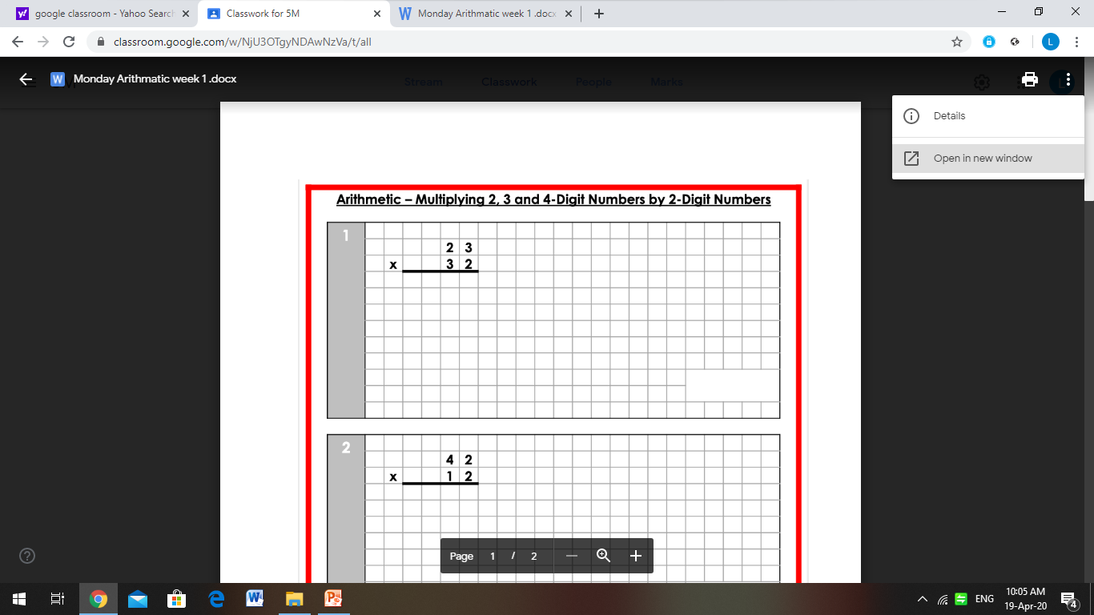
Press on the three dots and select ‘open in new window’

Slide 3
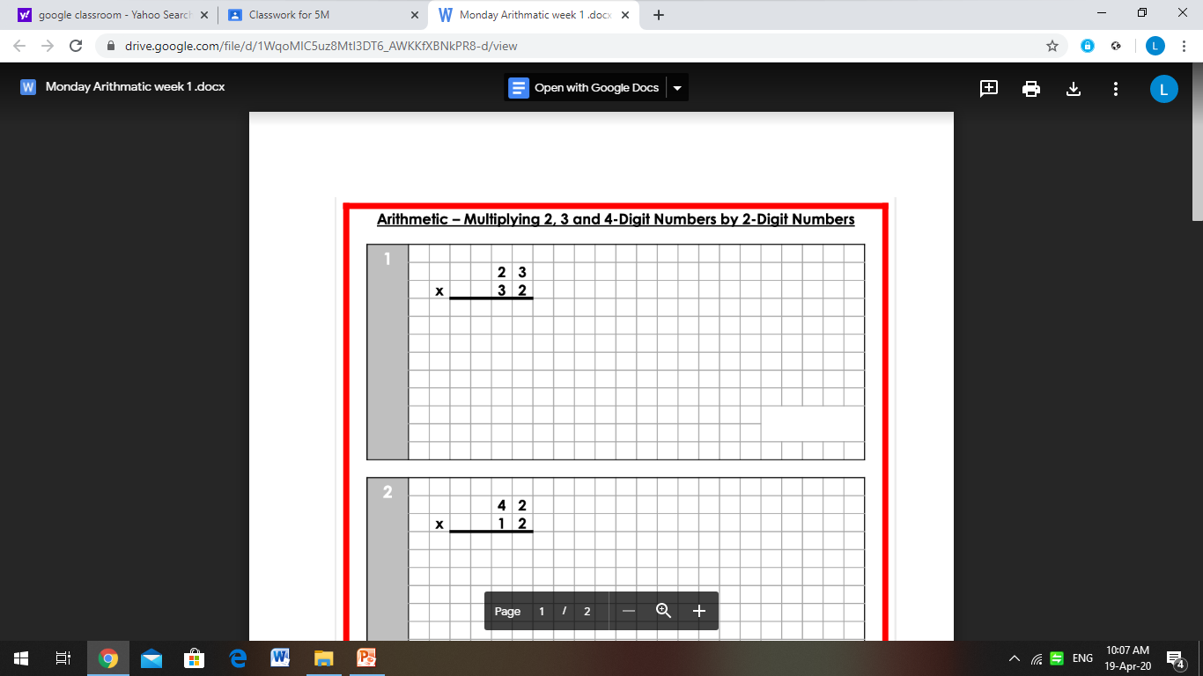
You can now select options in order for you to edit.

Slide 4
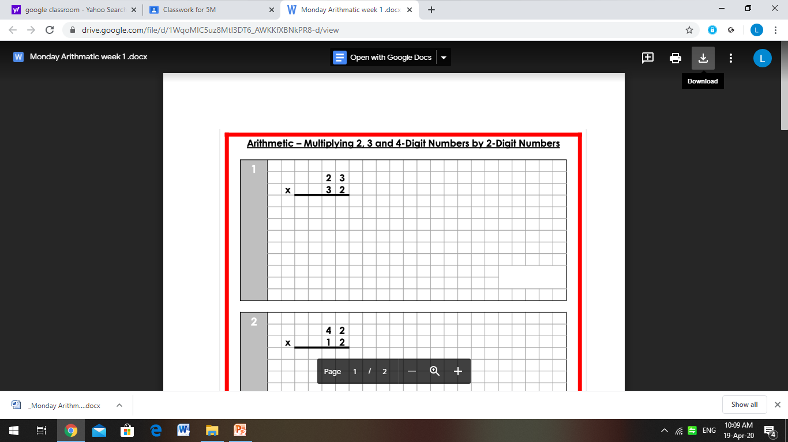
If you have Microsoft word installed on your device, click download.

Slide 5
You will notice the document downloading at the bottom.

Slide 6
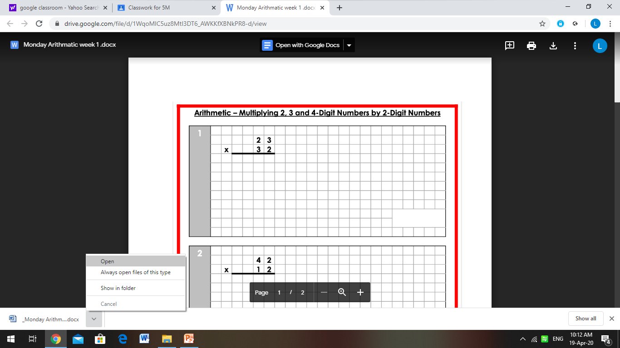
Click the arrow and ‘open’. The work will open in Microsoft word.

Slide 7
If you don’t have Microsoft word, you can open the work in ‘Google Docs’

