Slide 1

Typing on a worksheet

Slide 2
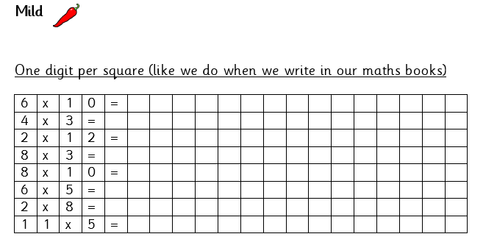
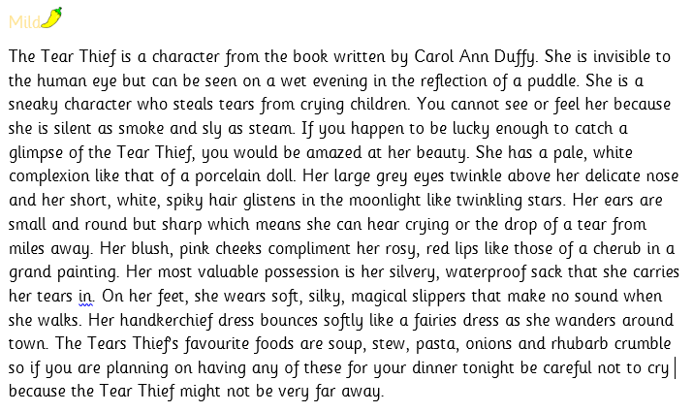
On some of the tasks the worksheets do not allow you to type straight onto them.

Slide 3
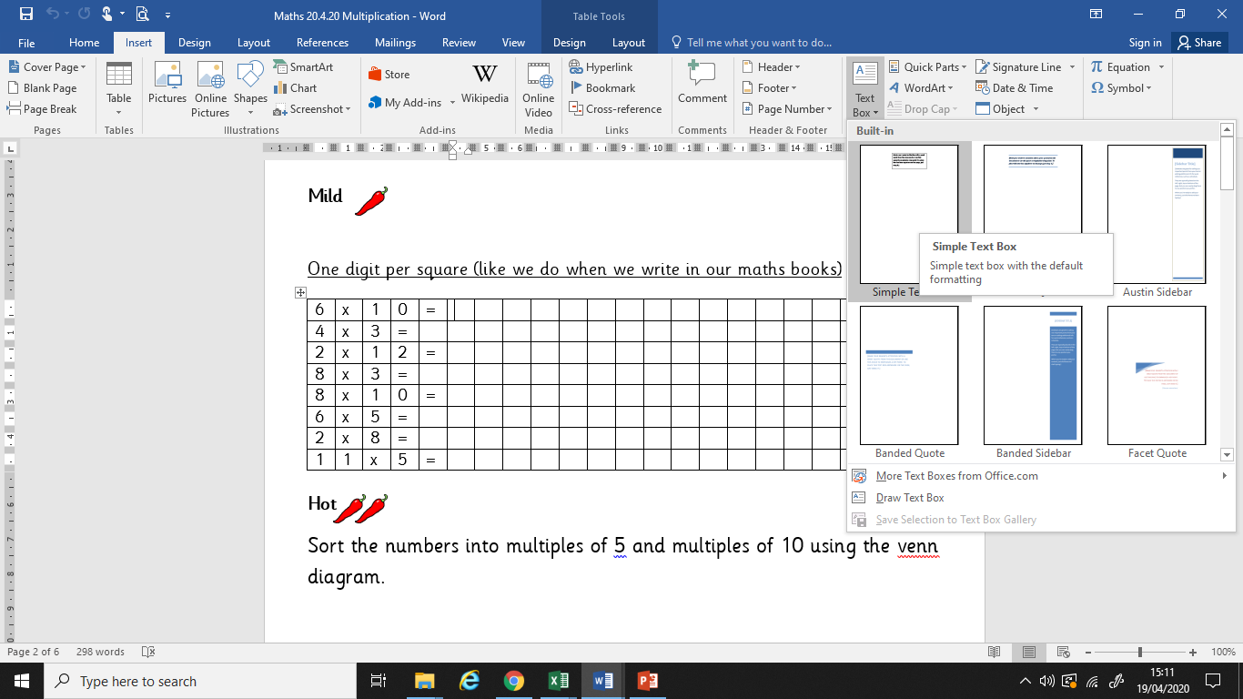
Click on:
Insert
Text box
Simple text box

Slide 4
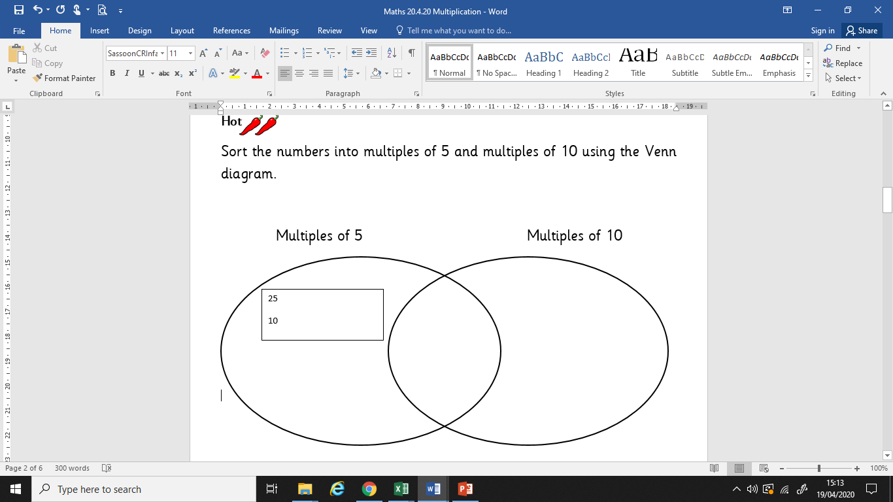
Once you have inserted the text box you can begin to type in it.

